Slide 1
CAREER ASPIRATIONS
GENERATION Z
SHIVANI SARAIYA

Slide 2
TABLE OF CONTENTS
04
01
EXPLORATORY DATA ANALYSIS
INTRODUCTION
05
02
ANALYZING GENZ DATA
PROBLEM STATEMENT
06
03
DATA COLLECTION
CONCLUSION

Slide 3
INTRODUCTION

Slide 4

INTRODUCTION
Generation Z refers to individuals born between 1997 and 2012.
As digital natives, they have grown up in an era characterized by rapid technological advancement, social media, and global connectivity.
Entering the workforce with fresh perspectives, they are redefining traditional workplace norms and expectations.

Slide 5
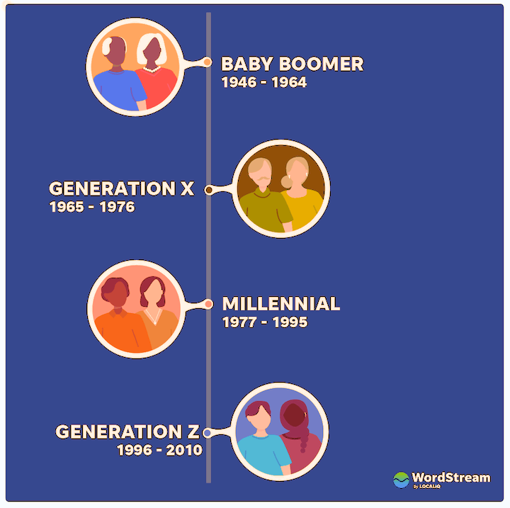
Unlike previous generations, Gen Z places a high value on purpose-driven work, mental health, and work-life balance
While Baby Boomers and Gen X largely prioritized job stability and financial security, and Millennials sought flexibility and meaningful engagement
Gen Z takes it a step further by demanding transparency, inclusivity, and authenticity from their employers.

Slide 6

What does this Project talk about?
This project explores Generation Z's problems, challenges, and evolving aspirations as they transition into the workforce.
It aims to understand what Gen Z values in a workplace, such as flexibility, purpose, and well-being, and how these preferences differ from those of previous generations.
By shedding light on their expectations, struggles, and career choices, the project helps uncover what truly matters to Gen Z in today’s rapidly changing professional landscape.

Slide 7

What is the Focus of the Project?
01
Aligned Mission Aspirations
This section explores Gen Z’s desire to work for organizations that align with their personal values. It focuses on how mission clarity, social responsibility, and purposeful work influence their career decisions.
02
Managerial Aspirations
03
Learning & Work-Life
Balance of Gen Z
This section highlights Gen Z’s expectations around leadership, growth, and feedback. It sheds light on their preference for transparent communication, inclusive work environments, and strong mentorship from managers.
This section delves into Gen Z’s priorities around continuous learning opportunities and maintaining a healthy balance between work and personal life. It reflects their emphasis on flexibility, well-being, and skill development.

Slide 8
PROBLEM STATEMENT

Slide 9






PROBLEM STATEMENT
hh
Who
What
Where
When
Why
How
The focus is on Generation Z, now entering or establishing themselves in various industries with priorities that differ significantly from past generations.
Gen Z desires more than just monetary benefits. They value flexibility, mental health support, personal development, and a sense of purpose at work.
Gen Z is impacting a broad range of industries—from corporate and startups to creative and tech fields
The time to act is now, as Gen Z forms a growing portion of the workforce and is already influencing hiring practices, workplace culture, and policy changes.
Traditional workplace models often clash with Gen Z’s values. Hierarchical structures and rigid systems lead to disengagement, job dissatisfaction, and high attrition rates
Organizations must evolve to align with Gen Z’s needs—offering flexible work schedules, growth opportunities, and open communication.
To understand Gen Z’s evolving career aspirations, the 5W1H framework has been applied, breaking down who they are, what they seek, and how organizations can adapt

Slide 10
DATA COLLECTION

Slide 11

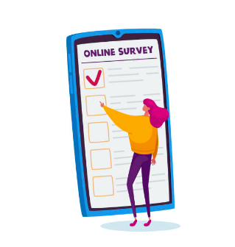
DATA COLLECTION
Data were collected through a structured Google Form survey to gain insights into Generation Z's career aspirations and workplace expectations.
The form was circulated among Gen Z respondents via peer networks and student communities, resulting in responses from over 3,000 participants.
The survey included only closed-ended questions—a mix of multiple-choice, yes/no, and rating scales—to ensure consistency and ease of analysis.
Participants were asked to rate statements such as their willingness to work for companies without clear social impact, and to identify their top job priorities.
Key areas explored included work-life balance, salary expectations, and organizational loyalty, particularly to understand how frequently Gen Z professionals switch jobs and the reasons behind those decisions.

Slide 12



Why this method?
Surveys are a cost-effective and efficient method for collecting large amounts of data in a relatively short period.
Their structured format ensures consistency across responses, which simplifies both quantitative and qualitative analysis.
They are particularly well-suited for reaching Generation Z, a tech-savvy demographic that is highly active on digital platforms.
Online surveys—especially those distributed through peer networks, social media, or student communities—are easily accessible to Gen Z and align with their preference for convenience, speed, and digital interaction.

Slide 13
EXPLORATORY DATA ANALYSIS

Slide 14

EXPLORATORY DATA ANALYSIS
Before we dive into the insights, it’s important to understand what kind of data was collected and what each part of the dataset represents.
This initial phase is known as Exploratory Data Analysis (EDA) — it’s essentially the process of getting familiar with the data to ensure it’s clean, complete, and ready for deeper analysis.
Think of EDA as a "first look" at the dataset. It helps answer key questions like:
What kind of responses were collected?
Are there any missing or inconsistent values?
Do any patterns stand out at a glance?
It’s like scanning the menu before placing an order — before we can interpret Gen Z’s career aspirations, we need to understand what’s on the table.

Slide 15

To begin, I examined the structure and content of the responses. The dataset includes demographic details (like gender and location), career aspirations, workplace preferences, and salary expectations.
The gender distribution revealed a diverse group of participants, including male, female, and transgender individuals, showcasing inclusivity in the data.
Most respondents were based in India, and to better understand the geographical spread, I also looked at the number of unique zip codes represented.

Slide 16
OVERVIEW OF DATA
1. How many responses were collected in the survey?
To accurately capture Gen Z's career aspirations, the initial 3,000+ responses were rigorously cleaned and standardized, resulting in a dataset of over 70,000 rows. This expanded data set allows for a more confident and insightful analysis.
2. What is the Gender distribution in the Dataset?
Around 60% of respondents identified as male, and 40% identified as female.
The transgender group comprised a small fraction of the respondents, at about 0.19%.
3. What are the career options recorded in the survey responses?
There are 16 Distinct Career options recorded in the survey like Content Creation, Entrepreneur, Sales, Project Management, Team Lead,Tech fields like UX Design, Software Development, Data Analytics etc.

Slide 17
OVERVIEW OF DATA
4. What are the Common Workplace Frustrations that GenZ face?
The common workplace frustrations faced by the respondants are ‘Unclear Work with No Goal’,‘Political Environment’, ‘Unsupportive Managers’, ‘High Stressful Job’, ‘Unclear work even though goal is clear ’ ‘Lack of transparency’ which contribute among the top 5 workplace frustrations
5. What is the percentage distribution of respondents based on their daily working hours?
According to the survey responses, around 62% of respondents reported working 8 hours per day, followed by 19% working 6 hours.
About 16% reported working 10 hours, while only 2% and 1% worked 12 and 14 hours respectively.

Slide 18
OVERVIEW OF DATA
6. What is the percentage of participants requiring a full week break, categorized by gender?
Females:
19.73% prefer taking a full week break once every 2 months (highest preference).
18.31% prefer taking a full week break once every 3 months (second highest).
2. Males:
23.52% prefer taking a full week break once every 3 months (highest preference).
19.26% prefer taking a full week break once every 2 months (second highest).
3. Transgender/Other:
Representation is very minimal in the dataset.
The most common preference among this group is taking a full week break once every 12 months (0.24%).
Insights:
Overall, the data underscores that planned, regular extended time off is a significant well-being factor for all genders. Organizations that offer structured, predictable long breaks (every 2–3 months) are likely to better support employee mental health, prevent burnout, and boost retention, especially among Gen Z.

Slide 19
OVERVIEW OF DATA
7. How do minimum salary expectations differ by Gender?
The average expected in-hand monthly salary for males is around ₹30,000, followed closely by females with expectations ranging between ₹28,000 and ₹30,000.
For others, the expected salary falls between ₹23,000 and ₹25,000.
8. What are the salary expectations for candidates with 3 years of experience?
For candidates with 3 years of experience, salary expectations show a strong upward trend.
The majority (33.16%) expect more than ₹50,000 per month.
A significant portion (20.04%) aim for salaries between ₹41,000 and ₹50,000.
About 17.08% expect salaries between ₹31,000 and ₹40,000, while 12.18% expect ₹26,000 to ₹30,000.
Only a small fraction expect lower ranges: 8.69% for ₹21,000–₹25,000, and even fewer (below 6%) for expectations under ₹20,000.
Insight:
Candidates with 3 years of experience predominantly expect salaries upwards of ₹40,000, indicating rising aspirations and market confidence at this experience level.

Slide 20
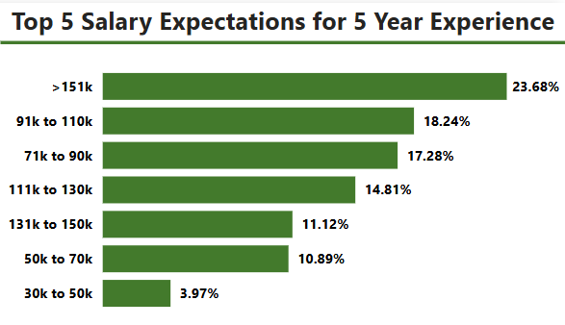
OVERVIEW OF DATA
9. What are the salary expectations for candidates with 5 years of experience or more?
After 5 years of experience, salary expectations rise significantly:
Nearly 24% of candidates expect salaries above ₹1.5 lakh per month — the largest group.
18.24% aim for salaries between ₹91,000 and ₹1.1 lakh, and 17.28% expect between ₹71,000 and ₹90,000.
About 14.81% set their expectations between ₹1.11 lakh and ₹1.3 lakh.
11.12% target ₹1.31 lakh to ₹1.5 lakh.
Smaller proportions expect ₹50,000 to ₹70,000 (10.89%) and ₹30,000 to ₹50,000 (3.97%).
Insight:
Expectations shift notably higher after 5 years, with a clear majority aiming for six-figure monthly salaries, reflecting ambitions for substantial career and financial growth.

Slide 21

OVERVIEW OF DATA
10. What is the percentage of work setup by respondants?
When it comes to preferred work setups:
The highest preference (32.09%) is for working in small teams of 5 to 6 people.
27.83% of participants prefer working in a large team environment.
27.32% prefer working with smaller teams of 2 to 3 people.
Only 12.76% prefer to work alone, highlighting a strong inclination toward collaborative work environments.
Insight:
A majority of individuals prefer teamwork, especially in moderately sized groups (5–6 members), emphasizing the importance of collaboration while maintaining manageable team dynamics.

Slide 22
UNVIELING INSIGHTS

Slide 23
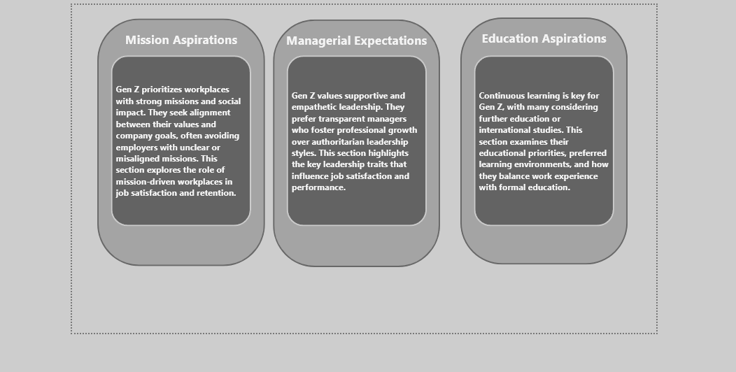
UNVEILING INSIGHTS

Slide 24
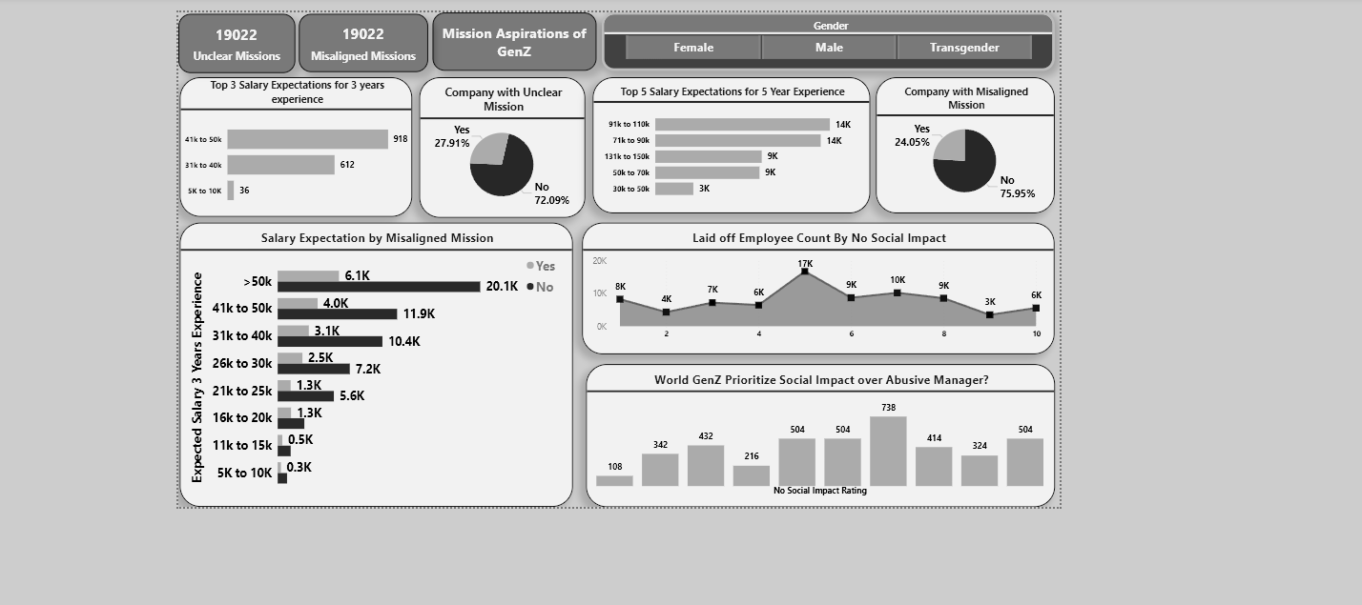
UNVEILING INSIGHTS

Slide 25
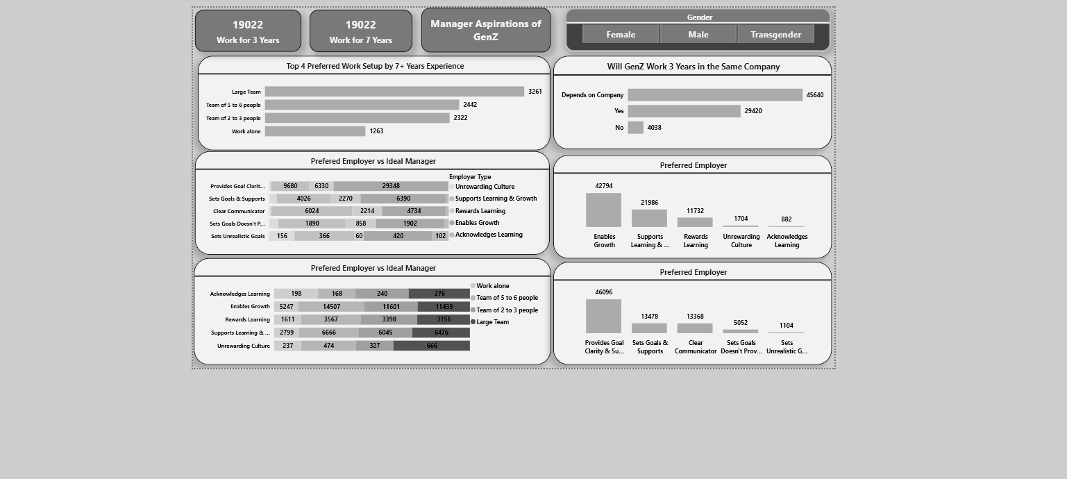
UNVEILING INSIGHTS

Slide 26
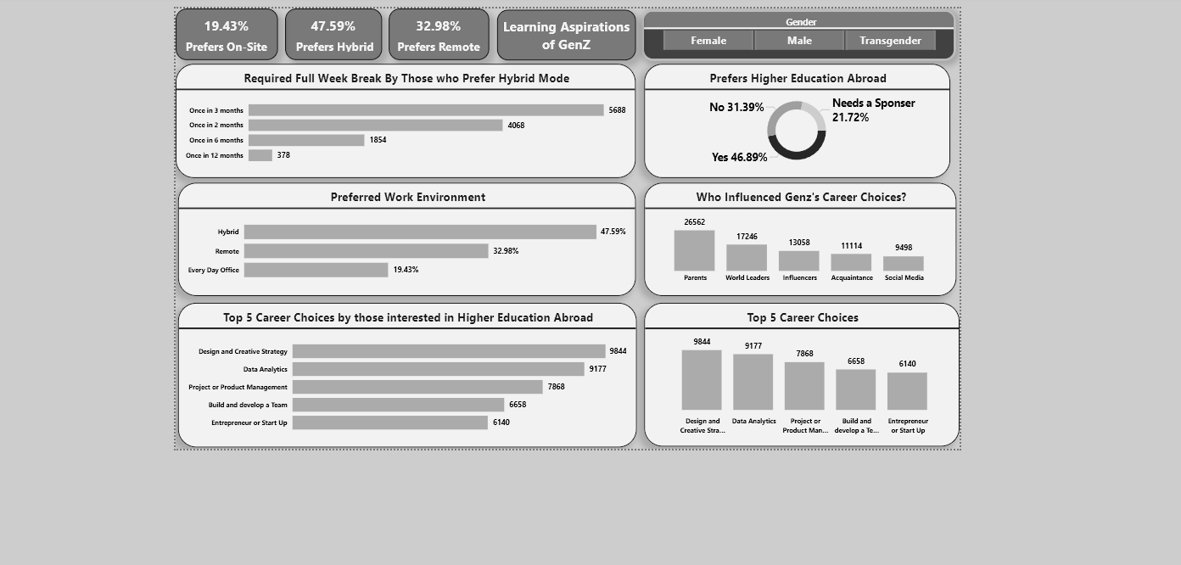
UNVEILING INSIGHTS

Slide 27
ALIGNED MISSION ASPIRATIONS
1. How many Gen Z individuals are willing to work for a company with no social impact?
When asked about their willingness to work for a company with no social impact
(rated on a scale from 1 to 10):
Lower ratings dominate — a large share rated 5 or below, indicating a strong preference against working for such companies.
The most common rating was 5 (16,676 respondents), reflecting neutral to slightly negative sentiment.
Ratings 6 to 8 (mid-range) had moderate representation, suggesting some openness but with caution.
Very few respondents rated 9 (3,450) or 10 (5,538), showing low enthusiasm for companies lacking social contribution.
Insight:
The data clearly shows that most respondents are hesitant or unwilling to work for companies without a positive social impact. Companies that prioritize social responsibility are likely to attract and retain more talent.

Slide 28
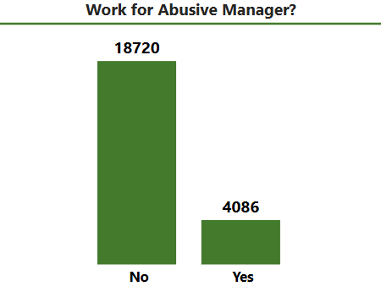
ALIGNED MISSION ASPIRATONS
2. Would Gen Z avoid working for Abusive Managers if given a choice?
When asked if they would work for an abusive manager:
A strong majority (18,720 respondents) said No, showing a clear unwillingness to tolerate toxic leadership.
Only 4,086 respondents said Yes, indicating very few are willing to stay despite abuse.
The gap between "No" and "Yes" responses highlights Gen Z’s strong prioritization of mental health and workplace respect.
Insight:
The data clearly shows that Gen Z employees are highly unwilling to work under abusive managers.
Organizations that fail to address toxic leadership risk high attrition and difficulty in attracting top talent.

Slide 29
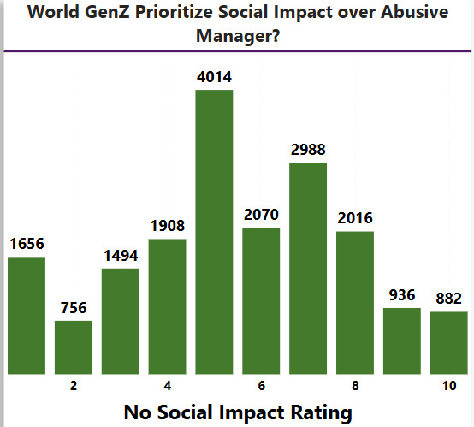
ALIGNED MISSION ASPIRATIONS
3. Are Gen Z more likely to avoid abusive managers if they prioritize social impact?
When asked about prioritizing working for a company with no social impact to avoid an abusive manager (rated 1–10):
Mid-range ratings dominate, with most respondents rating around 5–7, reflecting conflicted or reluctant acceptance.
The most common rating was 5 (4014 responses), showing neutrality and inner conflict rather than strong agreement.
High ratings (8–10) were relatively low, indicating that only a smaller group firmly prioritizes personal well-being over company values.
Low ratings (1–4) were also significant, suggesting a strong segment still values social impact highly.
Insight:
The data reveals that while many Gen Z individuals would prioritize avoiding abusive managers even if it means compromising on social impact, a substantial portion still strongly values working for socially responsible companies. Companies must foster both safe environments and social responsibility to win Gen Z loyalty.

Slide 30
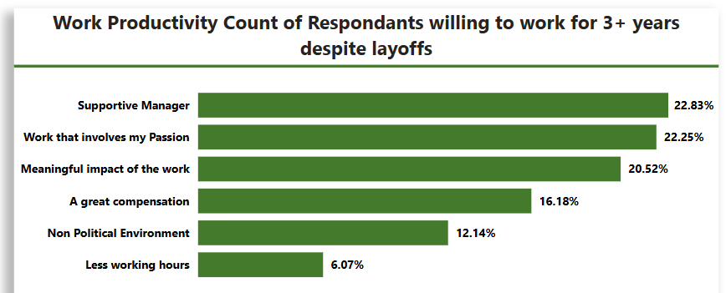
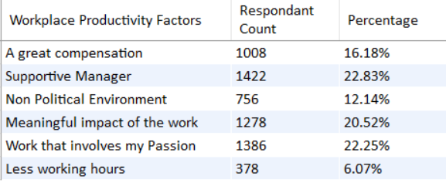
ALIGNED MISSION ASPIRATIONS
4. What are the count and percentage for happy productivity among those willing to stay 3+ years despite layoffs?
What Gen Z Wants for Workplace Productivity:
Supportive Managers (22.83%) aren’t just a nice-to-have—they’re a must for keeping Gen Z motivated and loyal.
Passionate Work (22.25%) isn’t just a preference; it’s a game-changer for engagement.
Making a Meaningful Impact (20.52%) matters—Gen Z wants their work to matter.
Great Compensation (16.18%) is nice, but purpose beats pay.
Non-Political Culture (12.14%) and Flexible Hours (6.07%) are important, but not top priorities.
Insights:
Gen Z is more likely to stick around—even through layoffs—if they’re led by a supportive manager and working on something they’re passionate about.
Compensation is important, but it’s purpose and a positive culture that will truly keep Gen Z committed for the long haul.

Slide 31
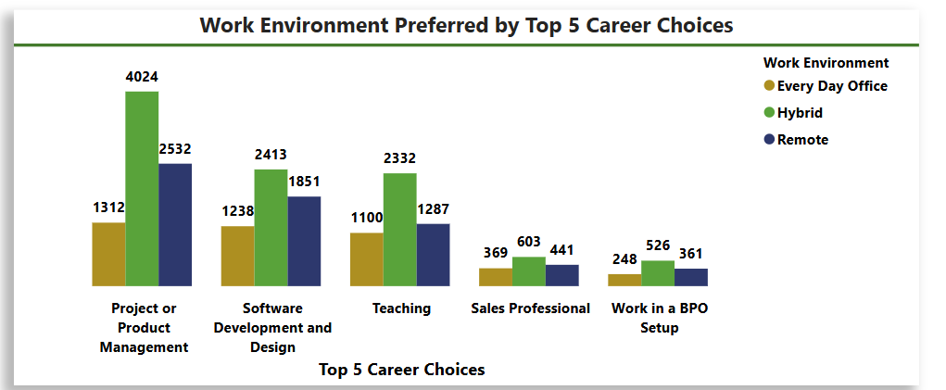
MANAGERIAL ASPIRATIONS
1. What is the count of preferred work environment by Top 5 career choice?
When talking about the work environment that Gen Z would prefer based on their top 5 career options:
Hybrid work clearly tops the list across all major career choices.
This highlights a crucial insight: Gen Z isn't just looking for a job—they're looking for flexibility, autonomy, and balance.
They want the option to collaborate in person when needed, but also the freedom to work remotely when it suits them best.
Insights:
Design flexible hybrid models as the default, not the exception, especially for roles like Project Management, Software Development, and Teaching.
Highlight your flexible work options in recruitment and retention strategies—it’s a major advantage in attracting and keeping Gen Z talent.
Recognize that different roles have slightly different work environment preferences—one-size-fits-all policies won't work. Tailor flexibility where possible.

Slide 32
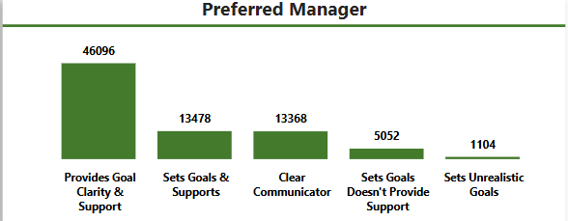
MANAGERIAL ASPIRATIONS
2. What kind of manager would GenZ prefer and why?
Managers can make or break an employee’s career, and Gen Z knows it. For Gen Z, a manager isn’t just a boss, they’re a mentor, a guide, a support system.
The data here suggests that providing end-goal clarity and support (not instructions!) is not negotiable. Gen Z doesn't want to guess what success looks like. They want managers who clearly understand goals, expectations, and the path forward.
The massive gap between 'Goal Clarity & Support' and 'Sets Goals & Supports' is a wake-up call. Gen Z craves certainty in a world that often feels uncertain. Managers who provide clear, structured goals win their trust and their loyalty.
Insights:
Goals clarity,support and required guidance and clear communication is what sets apart a great manager from others.
When goals are vague, even the best support feels empty. Gen Z is willing to stay and grow but only where they know exactly how to succeed.

Slide 33
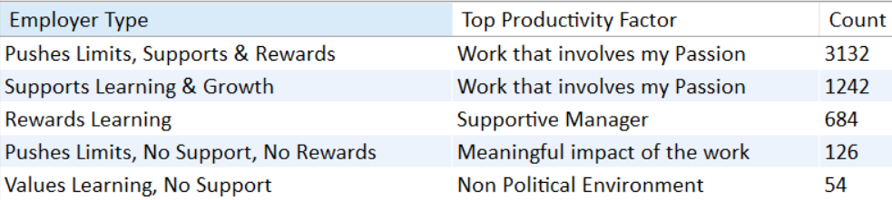
MANAGERIAL ASPIRATIONS
3. Can Work Productivity Factors be Influenced by the type of Employer?
When employers support learning and growth or push limits while also rewarding efforts, Gen Z thrives when their work aligns with their personal passion, this was the most dominant theme, with a combined 4374 responses.
For employers that primarily reward learning, having a supportive manager becomes the key productivity driver. Here, 684 participants highlighted that leadership support makes a meaningful difference.
However, in environments lacking support, where learning exists without encouragement, or where limits are pushed without rewards,Gen Z shifts their focus. In these cases, factors like a non-political environment (54 responses) and meaningful impact of their work (126 responses) become much more important to sustain their productivity.
Insights:
Support + Growth + Rewards = Passion fuels productivity.
Rewards alone = Need for strong managerial support.
No support = Need for meaning and fair environment.

Slide 34
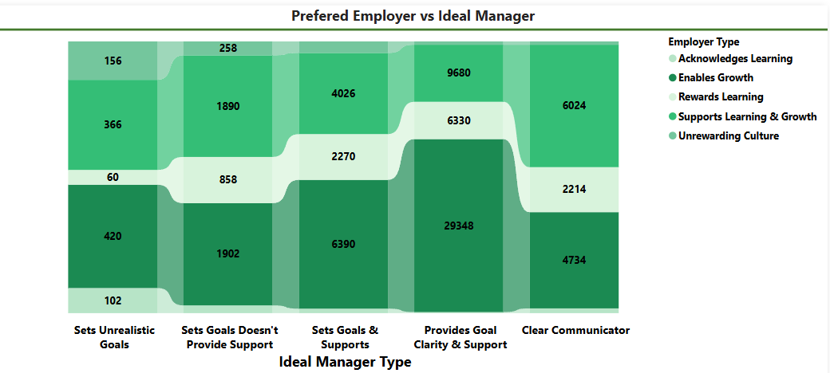
MANAGERIAL ASPIRATIONS
4. What type of manager do Gen Z employees prefer under different employer cultures?
Across all employer types, most Gen Z respondents prefer managers who provide goal clarity and support. The highest count (29,348) came from those working with employers that support learning and growth showing a strong link between a growth-oriented culture and the desire for structured, supportive leadership.
6,024 respondents from "Supports Learning & Growth" preferred clear communicators, second only to those favoring clarity and support. This shows that Gen Z values not just support but also transparency and clarity in how goals are conveyed.
In unsupportive environments (e.g., Unrewarding Culture), expectations shift.
Even in such environments, Gen Z leans toward managers who set and support goals (2,270) or at least provide goal clarity and support (6,330). This indicates that managerial style can partially compensate for a lacking employer culture.
Insights:
No matter the employer type, Gen Z wants structure and support from their managers. Investing in managerial training that focuses on clarity, communication, and support will pay off across the board.

Slide 35
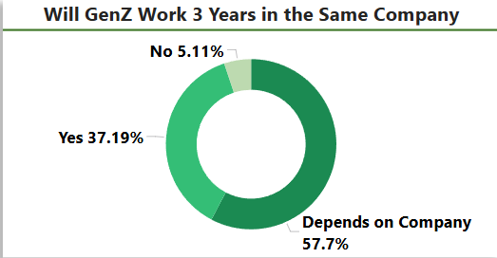
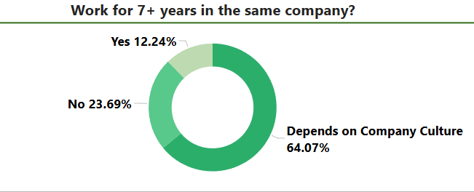
MANAGERIAL ASPIRATIONS
5. If given a choice would GenZ work under the same company for 3 years or more? How does it differ from those working long term?
Company culture is a dealbreaker.
A majority of Gen Z (57.7% for 3+ years, 64.07% for 7+ years) say their decision to stay depends entirely on the company culture. This shows that long-term loyalty isn't automatic — it must be earned through a culture that aligns with their values.
Job hopping is likely unless growth and support are present.
Only 12.24% are willing to stay for 7+ years outright — meaning most Gen Z professionals will switch companies if they don’t feel invested in. For them, loyalty is tied to continuous growth, meaningful work, and supportive environments.

Slide 36
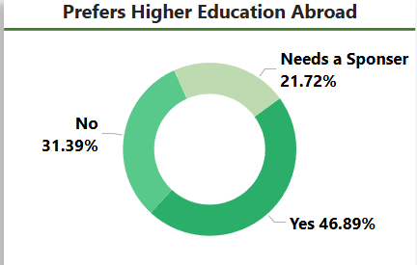
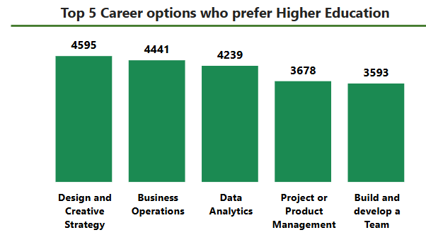
LEARNING ASPIRATIONS
1. What Percentage are interested in Pursuing Higher Education Abroad? What are the top 5 career options if they pursue higher education?
The data shows that 47% of Gen Z respondents are willing to pursue higher education abroad if given the opportunity. Around 32% prefer not to, while a notable 21.7% would consider it if financial assistance or sponsorship were available.
This highlights a crucial insight: if the right support is provided, a much larger portion of this generation could be encouraged to pursue global education as a way to advance their careers.
Those interested in studying abroad are aiming for careers in areas like UX/UI and product design, business operations, data analytics, and project or product management—fields that are not only in high demand but also constantly evolving, especially with the rise of AI.
These roles often require strong educational foundations, practical skills, and global exposure, making higher education abroad a valuable stepping stone.
Insights:
Colleges and companies can unlock untapped potential by offering scholarships or financial aid programs specifically for career-aligned fields.
Companies can partner with universities abroad to sponsor students in exchange for post-education internships, capstone projects, or short-term work commitments as a way to provide learning as well as hands - on experience which is of utmost importance.

Slide 37
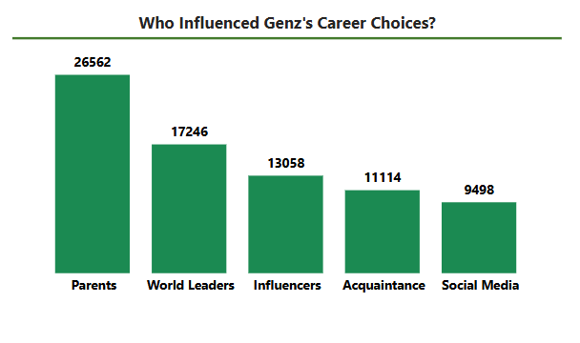
LEARNING ASPIRATIONS
2. What are the top factors influencing Gen-Z's career choices?
Gen Z places high importance on parental approval and guidance when making career choices, showing that family influence remains central in their lives
World leaders come second in influence, suggesting Gen Z looks up to individuals who embody inspiration, leadership, and values they aspire to reflect in their own careers.
Influencers carry significant weight, especially those who have made a real impact. Gen Z values authenticity and is drawn to people who have achieved success through purpose and effort, often seeing them as relatable role models.
The close numbers between influencers and acquaintances indicate that networking and personal connections play a vital role in Gen Z’s career decision-making. They recognize that visibility and connections are essential, and success alone is not enough without the right exposure.
Social media ranks lowest among influencers, showing that Gen Z increasingly prioritizes real, informed guidance over surface-level or misleading content. They are becoming more discerning in choosing knowledge over hype.

Slide 38
CONCLUSION

Slide 39

CONCLUSION
Gen Z’s career choices are shaped by a deep sense of purpose, personal growth, and the desire to lead with impact. They are not simply chasing jobs they are aligning their careers with their values, passions, and long-term vision.
The data reflects a generation that seeks guidance from trusted and authentic sources. While parents remain the strongest influence, Gen Z also looks up to global role models and peers who have walked meaningful paths.
Their aspirations fall into three core categories:
Mission Aspirations: A desire to contribute to causes greater than themselves.
Learning Aspirations: A hunger for continuous development and relevant knowledge.
Managerial Aspirations: A readiness to take on leadership roles backed by real-world skills and visibility.
Gen Z values authentic influence over popularity, networking over isolation, and knowledge over hype. These priorities redefine how they navigate opportunities in a complex, rapidly evolving world.As they shape the future workforce, it becomes essential for educators, employers, and mentors to recognize their values, provide meaningful engagement, and foster environments where purpose and performance coexist.

